Slide 1
Task Analysis
Task analysis is the process of learning about ordinary users by observing them in action to understand in detail how they perform their tasks and achieve their intended goals.
Tasks analysis helps identify the tasks that your website and applications must support and can also help you refine or re-define your site’s navigation or search by determining the appropriate content scope.

Slide 2
Purpose of Task Analysis
A task analysis helps you understand:
What your users’ goals are; what they are trying to achieve
What users actually do to achieve those goals
What experiences (personal, social, and cultural) users bring to the tasks
How users are influenced by their physical environment
How users’ previous knowledge and experience influence:
How they think about their work
The workflow they follow to perform their tasks

Slide 3
When to Perform a Task Analysis
It’s important to perform a task analysis early in your process, in particular prior to design work. Task analysis helps support several other aspects of the user-centered design process, including:
Website requirements gathering
Developing your content strategy and site structure
Wireframing and Prototyping
Performing usability testing

Slide 4
Types of Task Analysis
There are several types of task analysis but among the most common techniques used are:
Cognitive Task Analysis is focused on understanding tasks that require decision-making, problem-solving, memory, attention and judgement.
Hierarchical Task Analysis is focused on decomposing a high-level task subtasks.

Slide 5
How to Conduct a Task Analysis
Identify the task to be analyzed.
Break this high-level task down into 4 to 8 subtasks. The subtask should be specified in terms of objectives and, between them, should cover the whole area of interest.
Draw a layered task diagram of each subtasks ensuring that it is complete
Produce a written account as well as the decomposition diagram.
Present the analysis to someone else who has not been involved in the decomposition but who knows the tasks well enough to check for consistency
It’s important to note that you need to decide to what level of detail you are going to decompose subtasks so that you can ensure that you are consistent across the board.

Slide 6
Hierarchical Task Analysis
a hierarchical task analysis provides an understanding of the tasks users need to perform to achieve certain goals.
You can break down these tasks into multiple levels of subtasks.
In user experience, you can use hierarchical task analysis to describe the interactions between a user and a software system.
When designing a new system, hierarchical task analysis lets you explore various possible approaches to completing the same task.
When analyzing an existing system, it can help you to optimize particular interactions.
When designing a new system, hierarchical task analysis lets you explore various possible approaches to completing the same task.
When analyzing an existing system, it can help you to optimize particular interactions.

Slide 7
Applying Hierarchical Task Analysis to User Experience
Hierarchical task analysis requires a detailed understanding of users’ tasks. You can achieve this understanding by
identifying users’ primary goals
detailing the steps users must perform to accomplish their goals
optimizing these procedures

Slide 8
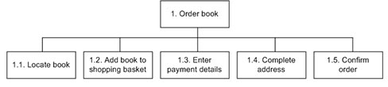
Example - Task: ordering a book.
Following figure shows a high-level hierarchical task analysis for this task.

Slide 9
Example - Task: ordering a book. (Contd.)
In this hierarchical task analysis, I’ve broken this task down into subtasks, expressing the relationships between the parent task and its subtasks through a numbering scheme.
This hierarchical task analysis is very coarse from a user experience standpoint.
It does not communicate any thing about what is happening at the level of a user’s interaction with the system. However, it does give a clear understanding of the task’s high-level steps.
A more complete task analysis would ultimately get down to the level of user interactions.

Slide 10
Example - Task: ordering a book. (Contd.)
To illustrate, Subtask 1.4, “Complete address,” would break down as follows:
Locate the Full Name field.
Move the insertion point to the field.
Type the full name.
Locate the Address Line 1 field.
Move the insertion point to the field.
Type the address.
Optional: Locate the Address Line 2 field.
Move the insertion point to the field.
Type the address.
Locate the Town/City field.
Move the insertion point to the field.
Type the town or city.
Locate the County field.

Slide 11
Example - Task: ordering a book. (Contd.)
Move the insertion point to the field.
Type the county.
Locate the Postcode field.
Move the insertion point to the field.
Type the postal code.
Locate the Country field.
Move the insertion point to the field.
Select the country from the drop-down list.
Locate the Phone Number field.
Move the insertion point to the field.
Type the phone number.

Slide 12
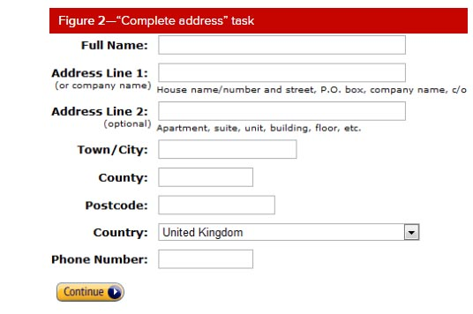
Example - Task: ordering a book. (Contd.)
Optionally, you can provide an illustration of the screen on which a user performs this task, helping to put this interaction in context.
Following Figure shows the screen for the “Complete address” task.

Slide 13
Example - Task: ordering a book. (Contd.)
Combining different approaches to describing user interactions provides an understanding of tasks that is both broad and deep.
The diagram shows how the high level steps of a task relate to one another. The structured breakdown of the task into its subtasks describes each interaction in detail.
The screenshot puts the interaction in context.

Slide 14
Example - Task: ordering a book. (Contd.)
It is advisable to create a plan that describes the way in which a hierarchical task analysis assembles the subtasks that let users achieve a particular goal and any conditions the subtasks must fulfill.
In many cases, users can simply work through the subtasks in a hierarchical task analysis, so keeping the plan separate from the tasks provides an additional degree of flexibility.
For the example hierarchical task analysis, there could be two different plans, as follows:
If a user is new to the system, complete Task 1.
If a user has registered and is signed in, complete Tasks 1.1, 1.2, and 1.5.

Slide 15
References
https://www.usability.gov/how-to-and-tools/methods/task-analysis.html
http://www.uxmatters.com/mt/archives/2010/02/hierarchical-task-analysis.php

